Slide 1
The new PowerPoint template is here!
Modern design, many targeted layouts, easy to use.
The new template offers many possibilities to create presentations in a uniform and modern look.
The following slides are intended to explain some of the basics of PowerPoint and contain a few tips and tricks on how to achieve a better end result more efficiently and easily.

Slide 2
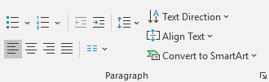
Font/text layers
Sub-headline optionally in gray
First list level for continuous text with highlight in text in bold
  Second list level for bullet points
    Third list level for Numberings
      Fourth list level for second bullet points
        Fifth list level for second Numberings
          Sixth list level for highlights and key statements
            Seventh text level for references and marginal notes
              Eighth text level for references and marginal notes
          List levels
To switch from one text level to the next, click in the text and use the buttons to increase or decrease the list levels. This function can be found in the “Paragraph” section on the “Start” tab.
The list levels should help to format texts quickly and uniformly and make everyday life easier when creating presentations. The levels should not be adjusted manually, as this would disrupt the functionality of the text field. If, for example, a letter is to be used as a bullet point instead of a number, this must be adjusted manually. To avoid errors, editing should only be done at the end.
Shift
Alt
Left/right arrow key

Slide 3
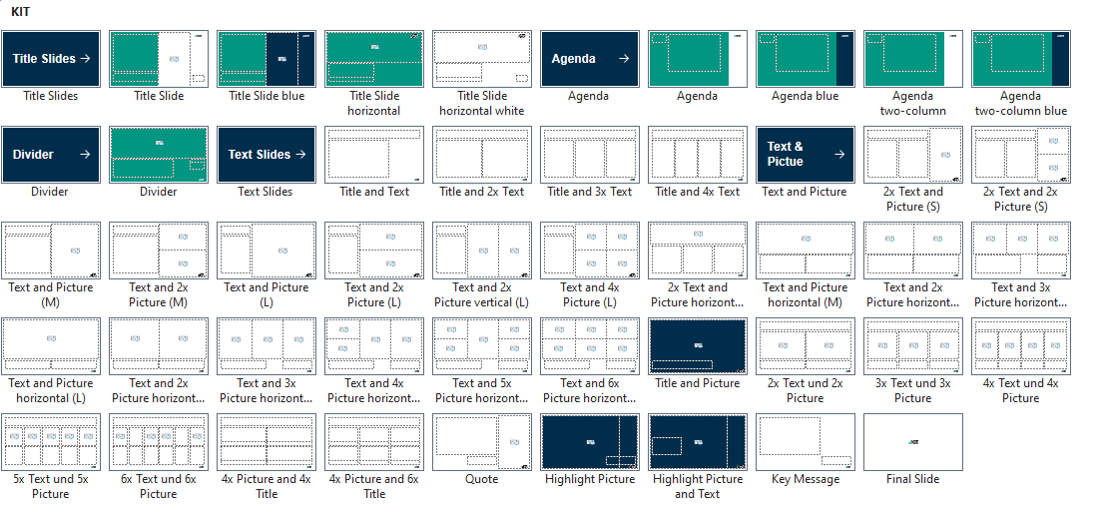
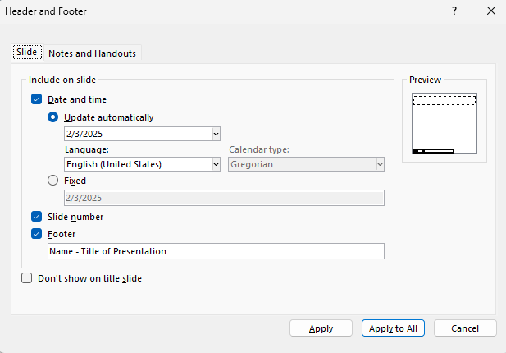
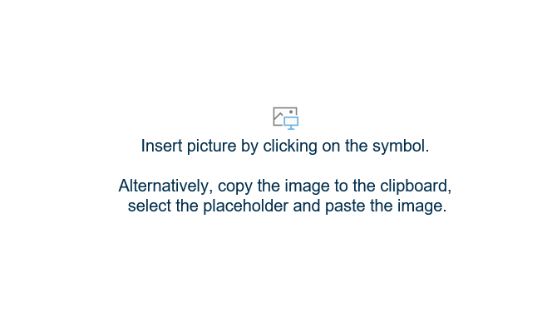
Layout, Footer and Pictures
There are also layouts without image placeholders.
          Select layout
There are many layouts to choose from depending on the content of the slide. The layouts can be found in the “Slides” section on the “Home” tab.
          Footer
The footer can be customized under
“Header and Footer” on the “Insert” tab.
          Placeholder for Pictures
There are 3 ways to insert an image:
    Click on the symbol and select a Picture.
    Drag & drop the Picture onto the placeholder.
    Copy the Picture in the folder [Ctrl+C], select the placeholder and paste [Ctrl+V].
Home
New Slide
Insert
Header and Footer

Slide 4



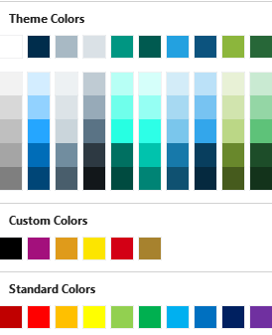
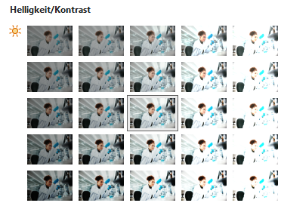
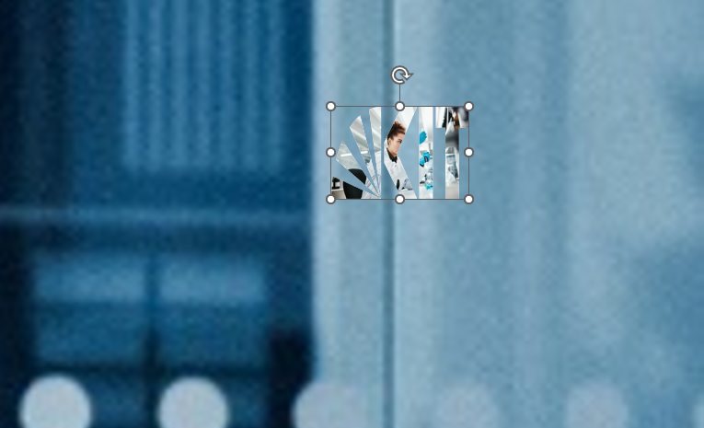

Logo Color and Reset
The KIT logo is often superimposed on Pictures. In rare cases, the logo must then
be recolored in black to ensure visibility.
To do this, go to the Shape format tab and select the color black under Shape fill.
Alternatively, the image can also be darkened via the Picture Format tab using the Corrections. The image must be selected for this.
1
1
2
3
2
3
Black
In addition, a bug occasionally occurs when changing layouts that causes pictures to jump into the logo placeholder. This cannot be prevented, but it can be corrected. All you must do is remove or cut out the picture.
The logo then jumps back to the correct position and is correctly colored again.
Delete Key
or
Cut out

Slide 5



Picture sources
To specify Picture sources, the text fields created here can be copied and positioned in the corresponding Picture corner. There are two predefined text boxes for image sources, one for the top left and one for the bottom left corner.
© Picture source top
© Picture source top
© Picture source bottom
© Picture source bottom

Slide 6
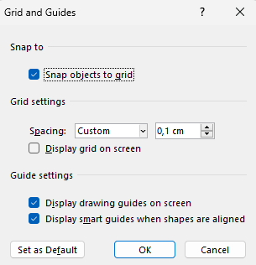
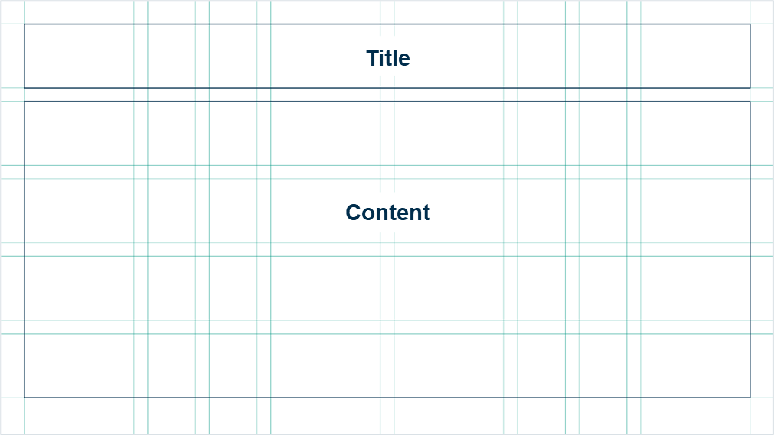
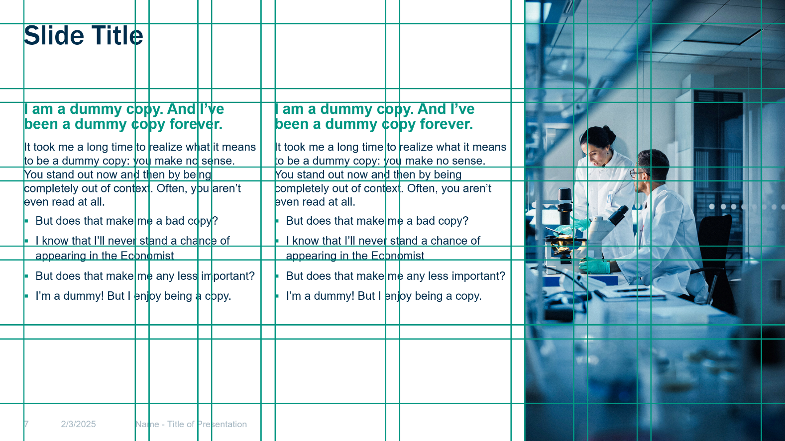
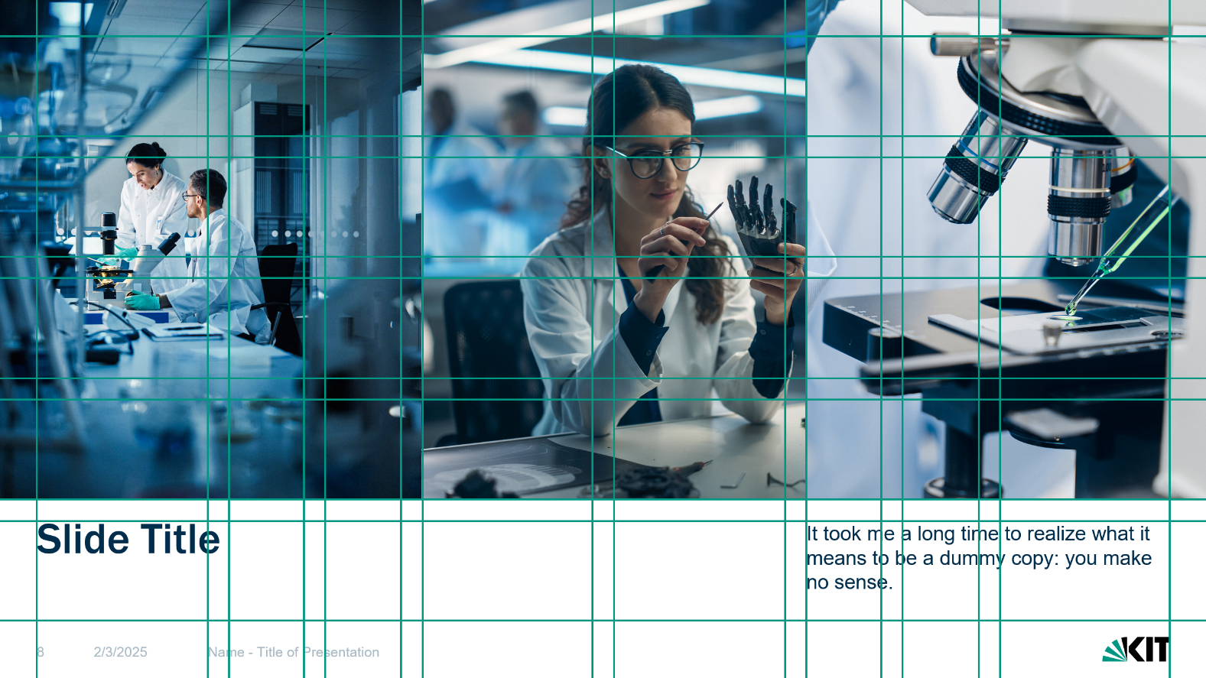
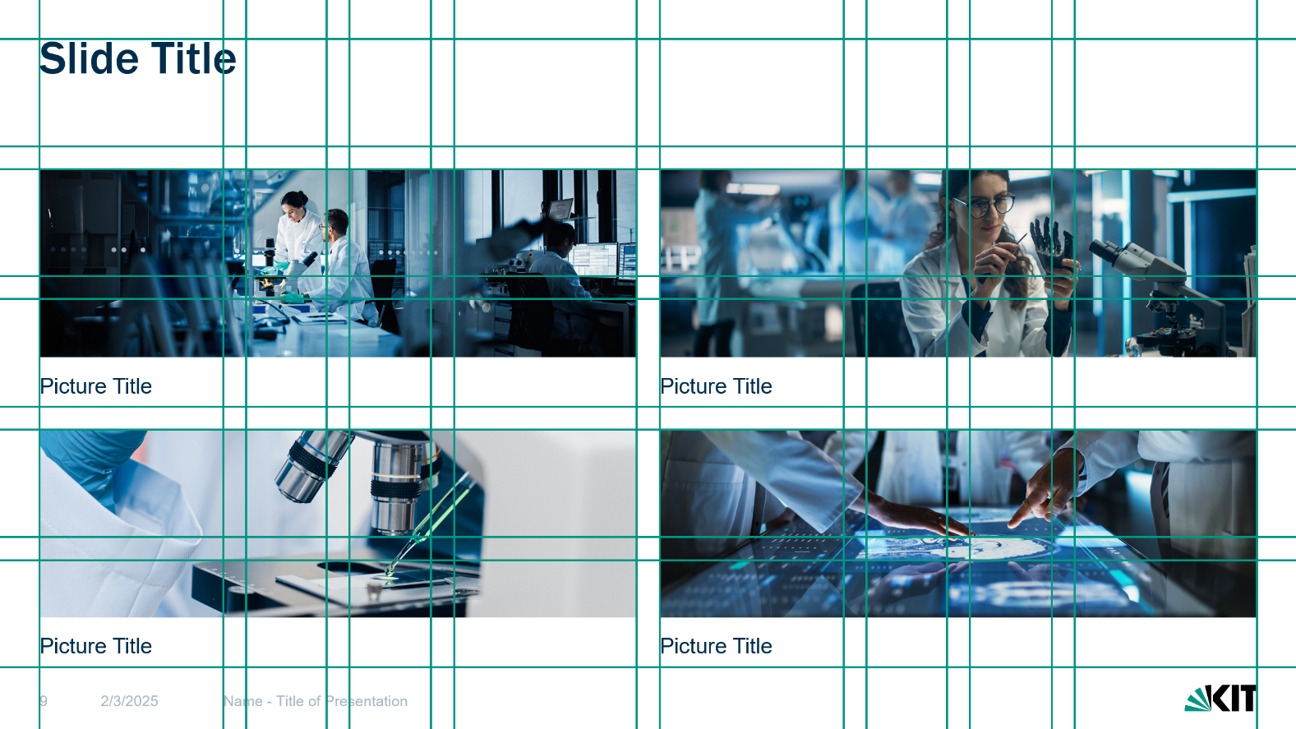
Grid and Guides
The drawing guides help with the uniform alignment of slide elements across several slides. If possible, text fields, images and graphics should be placed on the appropriate guides.
Select the settings according to the screenshot.
Right-click next to the slide
Grid and Guides

Slide 7
Colors
The colors in the Theme Colors section should be used for the slide design.
In addition, the Custom Colors can be used in exceptional cases.
The Standard Colors should not be used.
Background and
text on elements
Text and graphic elements
Lines, footer and graphic elements
Lines and graphic elements
Highlight colors mainly as subtle spot colors in the design or in diagrams and charts.
100% Black.
Custom colors to complement the highlight colors. These should only be used in exceptional cases.

Slide 8
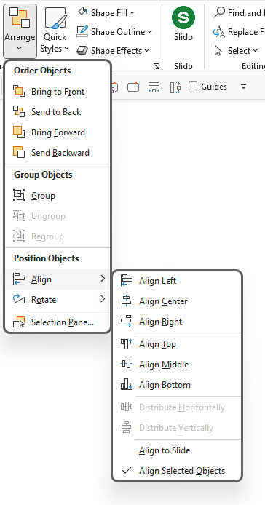
Alignment
          Scaling
When scaling up or down, hold
down the button to maintain the aspect ratio (use the marker points in the corners of an object).
          Move
Press and hold the button when moving to move objects along the vertical or horizontal line.
          Duplicate
Hold down the button while moving to duplicate the object. Both in combination help to create processes or timelines quickly and easily.
          Align
The alignment functions are located under Home > Arrange > Align or can be accessed by right-clicking.
Shift
Ctrl
Shift
Ctrl
Shift

Slide 9
PowerPoint Shortcuts English
Presentation from beginning
Presentation from current slide
Save
Save as…
Undo
Redo
F5
Shift
F5
Ctrl
S
Ctrl
Shift
S
Ctrl
Z
Ctrl
Y
Copy
format
Paste
format
Group
Ungroup
Zoom in/out
Search
presentation
Ctrl
Shift
C
Ctrl
Shift
V
Ctrl
G
Ctrl
Shift
G
Ctrl
Ctrl
F
Cut
Copy
Paste
Text align left
Text align center
Text align right
Ctrl
X
Ctrl
C
Ctrl
V
Ctrl
L
Ctrl
E
Ctrl
R
Text bold
Text italic
Toggle text case
Select next
object
Select previous object
Select all
objects
Ctrl
B
Ctrl
I
Shift
F3
Tab
Shift
Tab
Ctrl
A

Slide 10
Design elements
Highlight Box
Lines
Text box
Highlight Box
Highlight Box
  Standard text box with bullet point
  Standard text box with bullet point
Highlight Box
Highlight Box
Highlight Box
Highlight Box
© Picture source top
Highlight Box
                1
                1
© Picture source bottom
Source: I am a dummy text. And I've always been a dummy text

Slide 11
Title of the presentation over several lines
Insert Name, OU Unit,
Date

Slide 12
Content
First chapter
Second chapter
  First subordinate theme
  Second subordinate topic
  Third subordinate topic
Third chapter
  First subordinate topic
  Second subordinate topic

Slide 13
Add title
Add text

